Slide 1
Teensy code compliation

Slide 2
Installing teensyduino on computer
https://www.pjrc.com/teensy/teensyduino.html

Slide 3
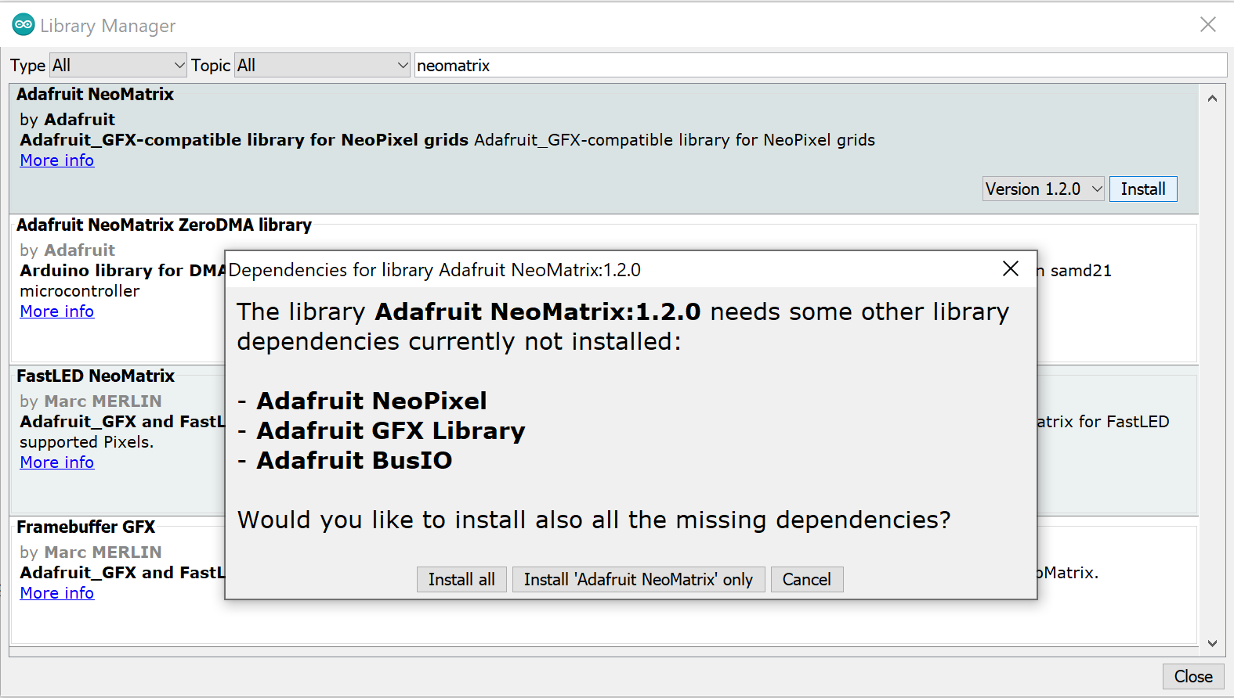
Installing libraries
Install all of these from sketch->include library-> manage libraries

Slide 4
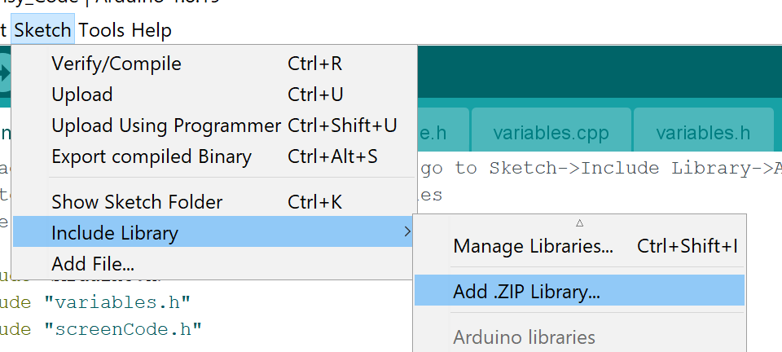
Add t3 libraries
These .zip files are included in the root directory
FlexCAN_t3.zip
HX8357_t3.zip

